Slide 1
Sequence Diagrams

Slide 2
Recall: Sequence Diagram
member:
LibraryMember
book:Book
:Book
Copy
ok = canBorrow()
borrow(book)
[ok] borrow(member)
setTaken(member)

Slide 3
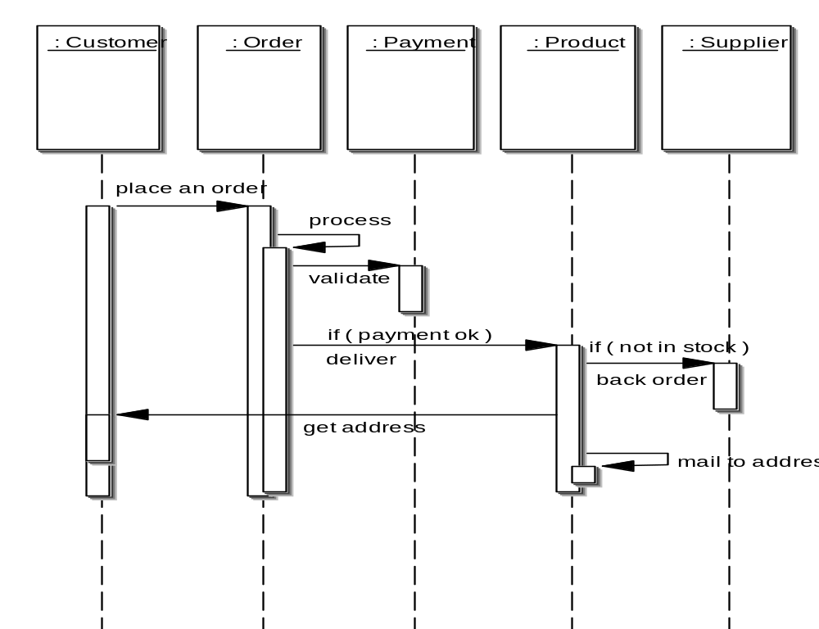
Elements of a Sequence Diagram
object
Activation
lifetime
message

Slide 4
Example Cont…
Sequence of message sending

Slide 5
An Example of A Sequence Diagram
:Library
Boundary
:Library
Book
Renewal
Controller
:Library
Book
Register
:Book
:Library
Member
renewBook
find MemberBorrowing
displayBorrowing
selectBooks
bookSelected
* find
[reserved]
[reserved]
apology
update
apology
confirm
confirm
updateMemberBorrowing
Sequence Diagram for the renew book use case

Slide 6
Message Arrows for Communication
Message arrows represent the type of communications between two objects in a sequence diagram:
  Synchronous message :
    Sending object suspends action and waits for the response to the message
  Asynchronous message:
    Sending object continues with its operations without waiting for the response
  A return of control from the synchronous message
  A creation of a new entity
(filled head)
(open head)

Slide 7
Asynchronous Messages
An example of this is a Timer in Java:
  An object that implements ActionListener may register itself as a listener for a Timer object
  The Timer object will store a handle to the object,
  Later, when the Timer expires, an event will be issued to the object's 'actionPerformed' method
Obviously, if the object had to wait for the timer to expire:
  It could have wasted a long period of potential computation time.

Slide 8
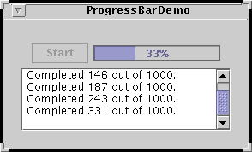
Example
timer = new Timer(ONE_SECOND, new TimerListener());
. . .
timer.start();
class TimerListener implements ActionListener {
public void actionPerformed(ActionEvent evt) {
progressBar.setValue(task.getCurrent());
if (task.done()) {
Toolkit.getDefaultToolkit().beep();
timer.stop();
startButton.setEnabled(true);
}
}
}

Slide 9
Asynchronous Messages Example
:ActionListener
inv:Inventory
addActionListener(self:ActionListener)
Time
…continue operation…
The eventual
response is
called a callback
actionPerformed(e: ActionEvent)

Slide 10
Return Values
Optional --- indicated using a dashed arrow:
  Label indicates the return value.
  Don’t need when it is obvious what is being returned, e.g. getTotal()
Model a return value only when you need to refer to it elsewhere:
  Example: A parameter passed to another message.
v

Slide 11
Summary of Kinds of Arrows
Procedure call or other kind of nested flow of control
(The sender losses control until the receiver finishes handling the message)
Flat flow of control(The sender does not expect a reply)
Return
(Unblocks a synchronous send)

Slide 12
Synchronous Messages
Flow of control, typically implemented as a method call.
  The routine that handles the message is completed before the caller resumes execution.
:A
:B
doYouUnderstand()
return (optional)
Caller Blocked
yes

Slide 13
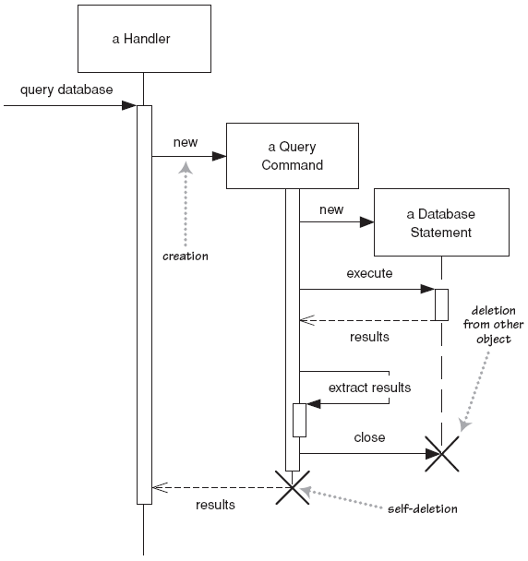
Lifetime of objects
creation: arrow with 'new' or create written above it
  Notice that an object created, appears at point of call.
deletion: an X at bottom of object's lifeline
  Java doesn't explicitly delete objects; they fall out of scope and are garbage-collected

Slide 14
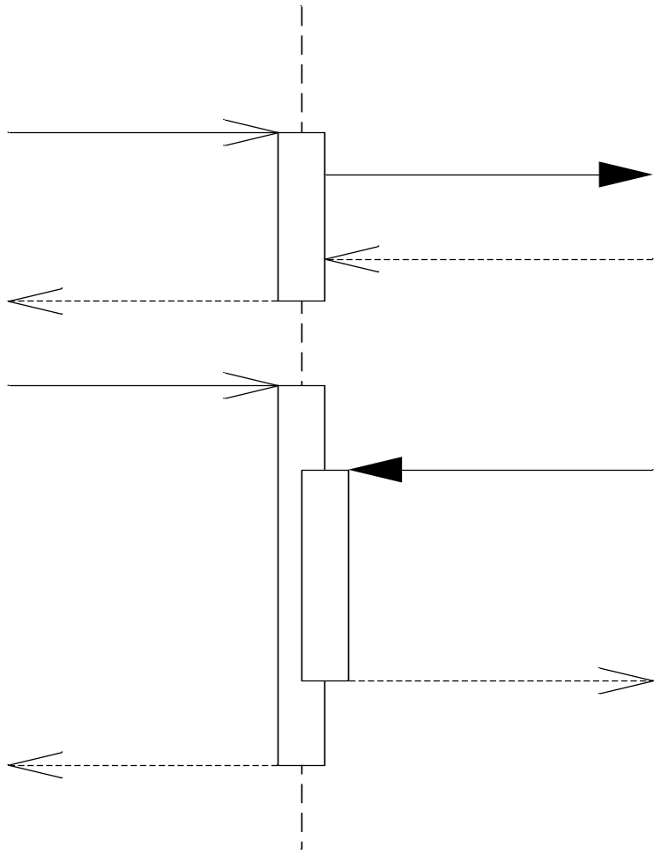
Method calls
Activation: thick box over object's life line; drawn when object's method is already on the stack
  Either that object is running its code, or it is on the stack waiting for another object's method to finish
  Nest to indicate recursion
Activation
:Controller
Nesting
Activation

Slide 15
Object Creation
An object may create another object via a <<create>> message.
:A
<<create>>
:B

Slide 16
Object Destruction
An object may destroy another object via a <<destroy>> message.
  An object may also destroy itself.
But, how do you destroy an object in Java?
  Avoid modeling object destruction unless memory management is critical.
:A
:B
<<destroy>>

Slide 17
Looping
Iteration example UML 1.x:
:CompoundShape
:Shape
draw()
*draw()

Slide 18
Exercise 0
A user can use a travel portal to plan a travel
When the user presses the plan button, a travel agent applet appears in his window
Once the user enters the source and destination,
  The travel agent applet computes the route and displays the itinerary.
  Then travel agent applet gets destroyed once the user presses any key

Slide 19
Exercise 0: Solution
:client
:travelAgent
plan
<<create>>
setItinerary
calculateRoute
[any key press]
<<destroy>>

Slide 20
Exercise 1
A traffic police uses a traffic violation app to find the details of any traffic violation by entering the violation id. Details of the interactions are the following:
The police first presses the view button in the Violation dialog box of the app.
  This request is conveyed to the server object
  The server object asks for the violation id
Once the police enters the violation id, the server queries the DBproxy object using the id
  Based on the response received from the DBProxy, the server creates a violation object and passes it to the dialog box for display.

Slide 21
Exercise 1: Solution
:Violations
Dialog
:Violations
server
:Violations
DBProxy
Police
view
view
id=getID()
getViolation(id)
v:Traffic
Violation
<<create>>
May be a pseudo-method
v
DB is queried and the result is returned as an object
display(v)

Slide 22
Method Population in Classes
Which methods should a class have?
  Methods of a class are determined from the interaction diagrams…
:Registration
:Registration
form
manager
RegistrationManager
add course
(joe, math 01)
addCourse(Student,Course)

Slide 23
Example Sequence Diagram: Borrow Book Use Case
member:
LibraryMember
book:Book
:Book
Copy
borrow(book)
ok = canBorrow()
[ok] borrow(member)
setTaken(member)

Slide 24
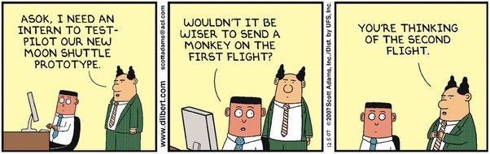

Slide 25
Sequence Diagram: Frames
A frame consists of:
  1) Diagram identifier
  2) Participants in a rectangle depicting the participating objects:
    A dotted line that extends for the time period of the interaction
  3) Messages to communicate among the participants
order process
:client
:order
:inventory
update
Locate item

Slide 26
Depicting a Frame Graphically
sd sample
:client
:order
:inventory
Interaction
Frame
update
operator
op1
Interaction
Frame
Operation
Name:
(e.g. loop)
Interaction Frame
Operand
Locate item

Slide 27

Combined Fragment: Syntax
op
[guard_1]
interaction_1
…
[guard_n]
interaction_n
Divided into a set of interactions by dotted lines
interaction_i is executed if guard_i is true

Slide 28
Frame Operators
Frame Operator | Meaning
Alt | Alternative fragment for conditional logic expressed in the guards
Loop | Loop fragment while guard is true. Can also write loop(n) to indicate looping n times.
Opt | Optional fragment that executes if guard is true
Par | Parallel fragments that execute in parallel
Region | Critical region within which only one thread can run

Slide 29
Fragment Operators: Full List
Skip
  Conditional: operator “opt”
  Loop: operator “loop”
  Branching: operator “alt”
  Reference: operator “ref”
  Parallel: operator “par”
  Critical Region: operator “critical”
  Interrupt: operator “break”
  Assertion: operator ‘’assert’’

Slide 30
Example Sequence Diagram
order
:StoreFront
:Cart
:Inventory
loop
AddItem
ReserveItem
Need not show: Implicit Return
Checkout
ConfirmOrder
ProcessOrder
PlaceItemInOrder

Slide 31
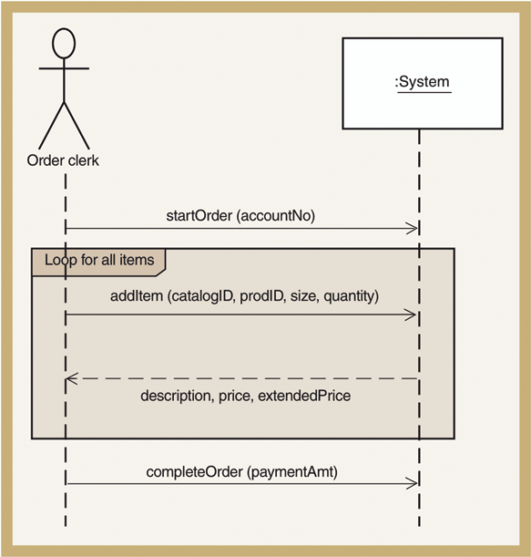
Sequence Diagram for Telephone Order use case
Repeat
Everything in
the rectangle

Slide 32
Alternative Fragment
sd sample
client
order
inventory
Combined
Interaction
Fragment
Interaction
Fragment
Operation
Name:
(Alternative)
Alt
[new_cust=yes]
cr_custinfo()
Interaction
Fragment
guards
[new_cust= no]
get_custinfo()
Cr_order( )
Interaction
Fragment
Operands

Slide 33
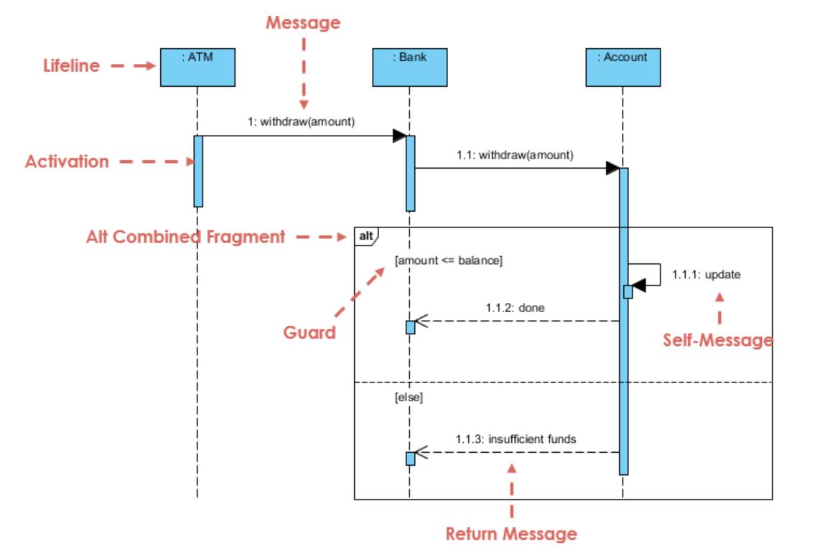
Example 2

Slide 34
Loop Fragment : Example
Search
:SearchEngine
:Repository
loop
[hasNext]
getNext()
test(item)
break
[found]
process(item)

Slide 35
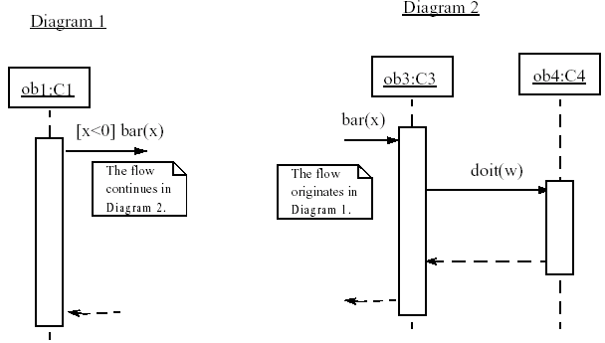
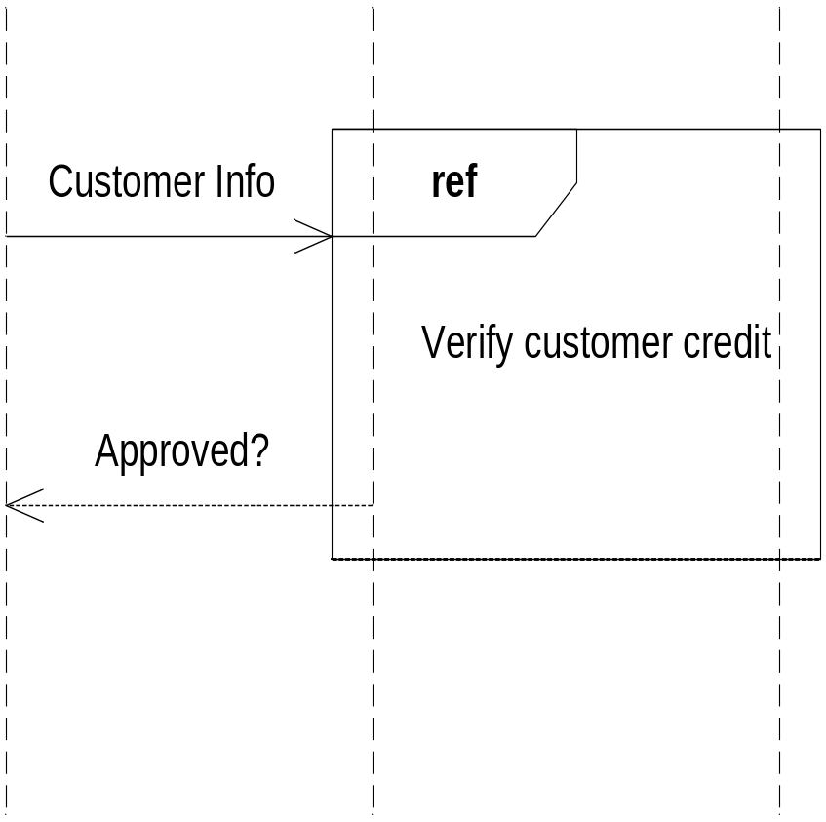
Linking Sequence Diagrams
If one sequence diagram is too large or refers to another diagram, indicate it with either:
  an unfinished arrow and comment
  a "ref" frame that names the other diagram

Slide 36
Nesting of Frames
:Foo
:Bar
m1
opt
[colour = red]
Loop
[n<100]
calculate
distribute

Slide 37
Exercise 2: Print Server
A print server is an active object
Client applications send jobs to the print server
The print server enqueues the received object by calling a queue object
The job server takes up jobs one by one from the queue:
  Prints them by sending them to the printer proxy

Slide 38
Exercise 2: Solution
Printing A
Document
Active object
:PrintServer
:Queue
:Printer
Proxy
Client
Application
print(doc,client)
enqueue(job)
loop
[queue-not-empty]
job=dequeue()
print(job)
status
done(status)

Slide 39
Code Generation
:Employee
:EmployeeDB
Emp=getEmployee(empId)
Public class EmployeeDB{
public Employee getEmployee(String empId){
…
}
}

Slide 40

Write Java Code…
:ShapeFactory
makeSquare
:Square
<<create>>
Public class ShapeFactory{
public Shape makeSquare(){
return new Square(); }
}

Slide 41
Exercise 3
:TreeMap
:TreeNode
clear
<<destroy>>
Public class TreeMap{
private TreeNode t;
public void clear(){
t=null;
}
}
Write Java Code

Slide 42
PurchaseItem Use Case: Sequence Diagram
Write Java Code for Controller
:Controller
purchase
<<create>>
:Purchase
public Class Controller {
private Purchase myPurchase;
private Payment myPayment;
public void purchase() {
myPurchase = new Purchase();
myPurchase.buyGrocery();
myPayment = new Payment( cashTender );
}
// . .
}
buyGrocery
<<create(cashTender)>>
:Payment

Slide 43
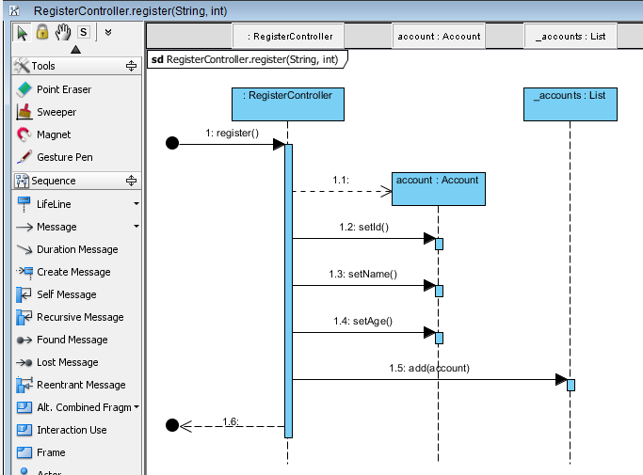
<<Create>>

Slide 44
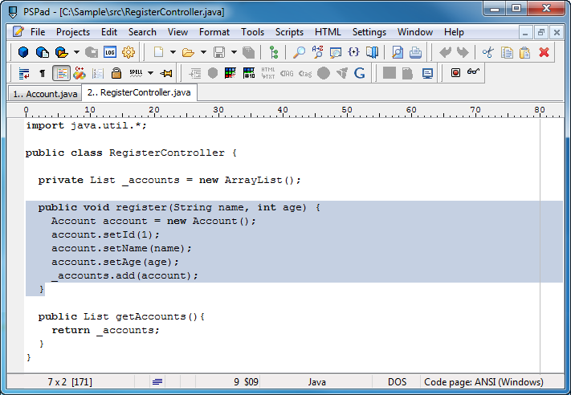

Slide 45
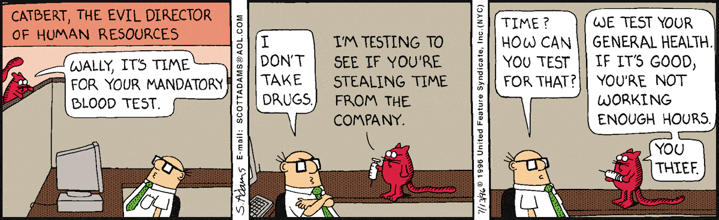

Slide 46
Exercise 6: Java Code for Sequence Diagram
:Account
:Order
:ShoppingBasket
alt
[ValidUser]
return()
placeOrder(Order: iOrderNo)
ref
return()

Slide 47
public void newTransaction(){
// behavior is an Interaction
if (ValidUser) // Alt combined fragment
{
placeOrder(iOrdNo); //Interaction Occurrence
}
else
{
return;
}
}

Slide 48
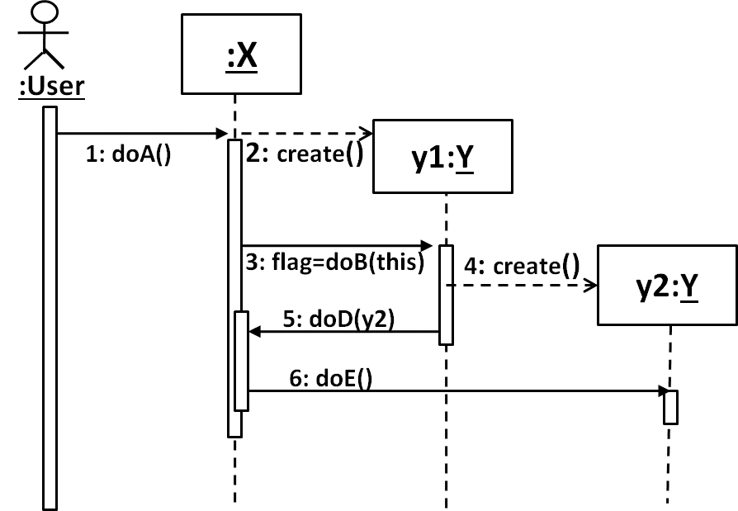
Quiz: Write Code for class B

Slide 49
Quiz: Ans
public class Y {
boolean doB(X x) {
Y y2 = new Y();
x.doD(y2);
return flag;
}
void doE() {---}
}

